Slide 1

Working of React
No need to worry about querying and updating DOM
React creates a web page with small and reusable components
React will take care of creating and updating DOM element
React saves a lot of time ,lots of things are already written

Slide 2

JS VS React
JS is imperative:
In JS you define steps to reach your desire state
React is Declarative:
We have to define target UI state and
then react figure out how to reach that state.

Slide 3
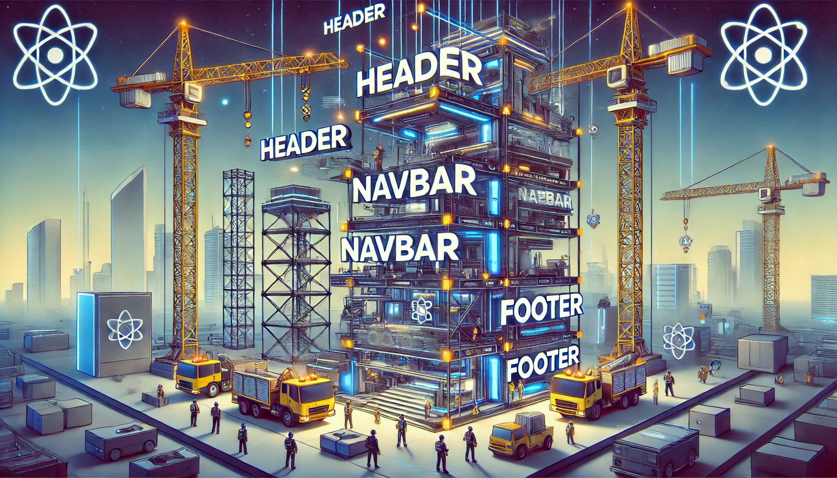
Introduction to components
In React, a component is a reusable, self-contained piece of UI that manages its own structure, behavior, and rendering.

Slide 4
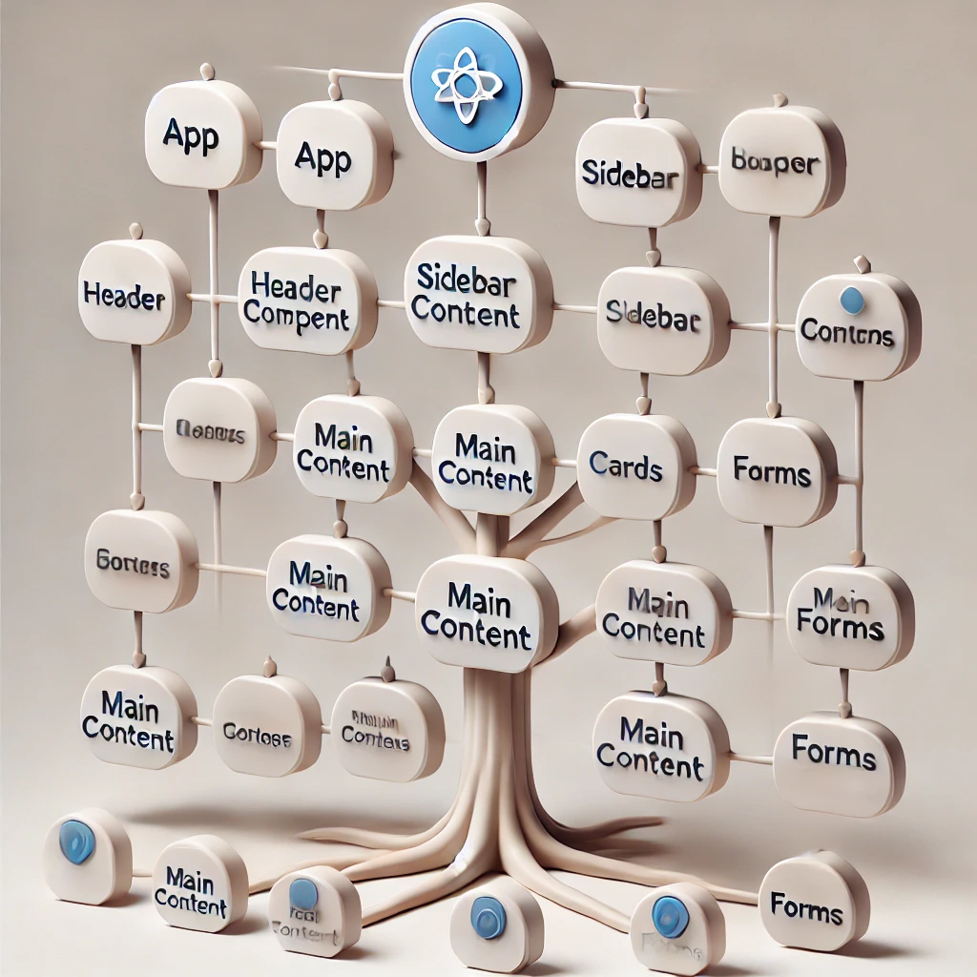
Create a React App
App is the root component and react application is a tree of component with App.

Slide 5

Create a React App
Setup IDE
Create a React App
Project Structure

Slide 6

What is IDE
An IDE (Integrated Development Environment) is a software application that provides tools for writing, editing, debugging, and running code. It simplifies software development by integrating various functionalities like a code editor, compiler, debugger, and build automation tools in one interface.
A user-friendly editor that highlights syntax, suggests corrections, and auto-completes code to make writing programs easier.
Helps identify and fix errors in the code by running it step-by-step and showing issues in real-time.
Converts human-written code into machine-readable instructions, allowing programs to run efficiently.
Organizes files, manages dependencies, and allows direct execution of code within the IDE itself.

Slide 7
Need of IDE
Code Efficiency & Speed – Provides auto-completion, syntax highlighting, and code suggestions to speed up development.
Built-in Debugging – Helps identify and fix errors with step-by-step execution and breakpoints.
Integrated Compiler & Interpreter – Converts source code into machine-readable format for execution.
Project Management – Organizes files, directories, and dependencies for better workflow.
Version Control Support – Integrates with Git and other tools for seamless collaboration and code management.
Code Refactoring – Allows easy modifications, restructuring, and optimization of existing code.
Multiple Language Support – Many IDEs support various programming languages in a single environment.
User-Friendly Interface – Simplifies coding for beginners and professionals with an intuitive layout.
Third-Party Plugin Support – Enhances functionality by allowing custom extensions and tools.
Real-Time Collaboration – Some IDEs offer cloud-based teamwork features for remote development.

Slide 8
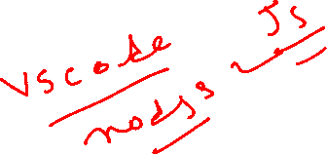
Installing Nodejs
Download and install nodejs from nodejs.org

Slide 9
Download and install VS Code
Download and install VS Codehttps://code.visualstudio.com/

Slide 10

Create a React App
Official tool is CRA(Create React APP)
Vite is a modern tool to create React Project
Vite produces Quick and Small bundle size
Vite: Use npm run dev to launch dev server
Use npm start for CRA

Slide 11
Project Structure
node_modules/ has all the installed node packages
Public/Directory: Contain static files that don’t change.
Src/Directory: Main folder for the React code
Components/: Reusable parts of UI
Assets/ : Images,fonts etc.
Styles/: CSS or stylesheets
4. package.json contain information about this project like name,version,dependencies on other react packages
5. vite.config.js contains vite config.

Slide 12
Understanding React
File Extensions
Class vs Function Components
What is JSX
Exporting Component
Dynamic Components
Resusable Component

Slide 13
File Extensions
.JS
Stands for javascript
Contains regular js code
.JSX
Stands for JavaScript XML
Combines JS with HTML like tags
Makes UI Design easy

Slide 14
Class vs Function Component
Class Components
Stateful: can manage state
Access to lifecycle methods
Not preferred anymore
Functional Components
Initially Stateless
Can us Hooks for state and effects
Concise and more Popular

Slide 15
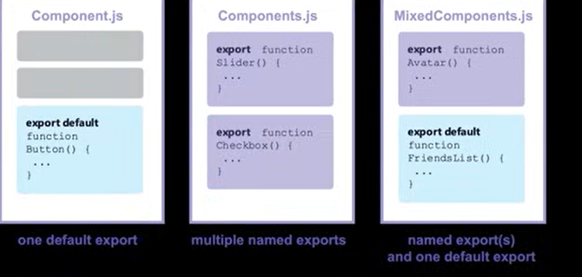
Exporting Components

